Slide 1
Graph Theory and Applications
CSM 491
Dr. Oliver Kornyo

Slide 2
Definition
Euler is the father of graph theory
Graph theory started with Euler who was asked to find a nice path across the seven Köningsberg bridges
The (Eulerian) path should cross over each of the seven bridges exactly once

Slide 3
Koningsberg Bridges

Slide 4
Kirchhoff and Cayley
Kirchhoff developed the theory of trees in 1847 to solve the linear equations in branches and circuits of an electric network.
In 1857, Cayley discovered the trees. Later he engaged in enumerating the isomers of saturated hydrocarbons with a given number of carbon atoms.

Slide 5
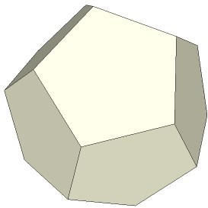
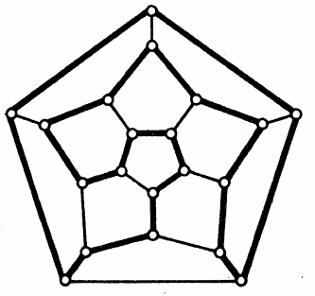
A game
In 1859, Hamilton used a regular solid dodecahedron whose 20 corners are labeled with famous cities.
The player is challenged to travel “around the world” by finding a closed circuit along the edges, passing through each city exactly once.

Slide 6
Applications
Psychology, Lewin 1936, life-space of an individual
Theoretical physics
Probability, Markov chains
Study of network flows
Gant charts

Slide 7
Graphs
A diagram consisting of:
A set of points
Lines joining certain pairs of these points
Example:
Points: people; lines: joining pairs of friends
Points: communication centers; lines: communication on links
Graph: G is an ordered triple (V, E, ψG)
V: nonempty set of vertices
E: set of edges
ψG: incidence function

Slide 8
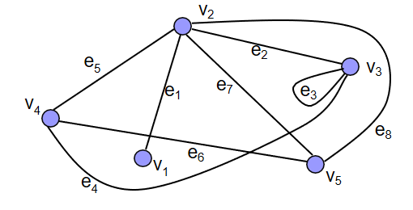
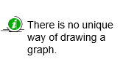
Example of a Graph
V = {v1, v2, v3, v4, v5}
E = {e1, e2, e3, e4, e5, e6, e7, e8}
ψG(e1) = v1v2, ψG(e2) = v2v3, ψG(e3) = v3v3 ψG(e4) = v3v4, ψG(e5) = v2v4, ψG(e6) = v4v5 ψG(e7) = v2v5, ψG(e8) = v2v5

Slide 9
Terminology
Two vertices which are incident with a common edge are adjacent.
An edge with identical ends: a loop.
An edge with distinct ends: a link.
Finite graph: both the vertex set and edge set are finite.
Simple graph: it has no loops and no two of its links join the same pair of vertices.

Slide 10
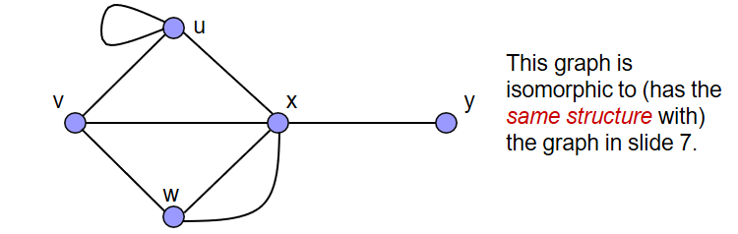
Isomorphism
Two graphs G and H are isomorphic if there are bijections:
Θ: V(G) → V(H)
Φ: E(G) → E(H) such that:
ψG(e) = uv if and only if
ψH(Φ(e)) = Θ(u) Θ(v)u

Slide 11
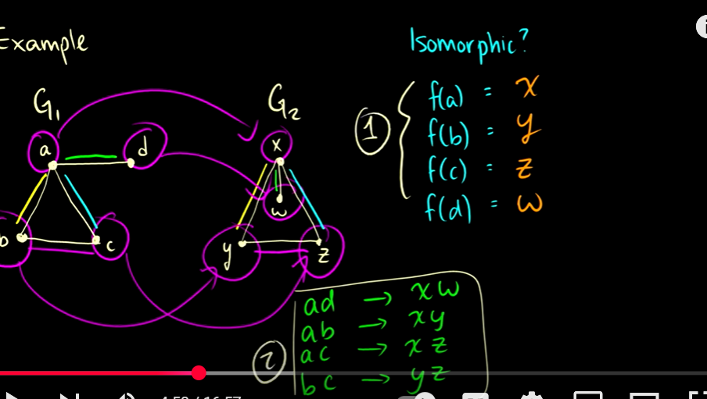
Isomorphism

Slide 12
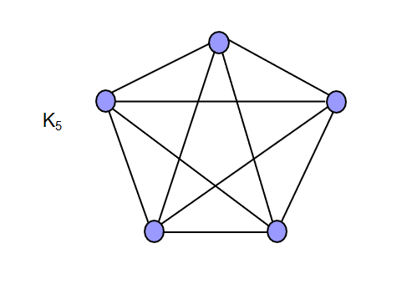
Complete Graph
Simple graph
Each pair of vertices is joined by an edge
Complete graph of n vertices: Kn

Slide 13
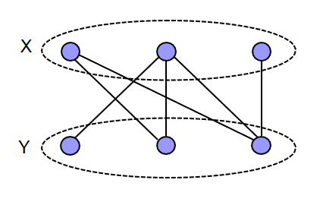
Bipartite Graph
Empty graph: a graph with no edges.
Bipartite graph:
Vertex set can be partitioned into two sets X and Y.
Each edge has one end in X and one end in Y.

Slide 14
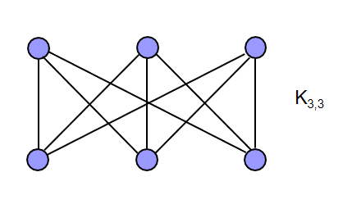
Complete Bipartite Graph
Complete bipartite graph: each vertex of X is joined to each vertex of Y.
Denoted by Km,n

Slide 15
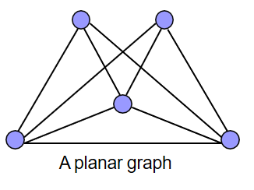
Planar Graph
Two edges in a diagram of a graph may intersect at a point that is not a vertex
Graphs that have a diagram whose edges intersect only at their ends are called planar.

Slide 16
Subgraphs
H is a subgraph of G if:
V(H) ⊆ V(G),
E(H) ⊆ E(G),
ψH is the restriction of ψG to E(H).
When H≠G, H is a proper subgraph of G.
If H is a subgraph of G, then G is a supergraph of H.
Spanning subgraph of G is a subgraph H with V(H) = V(G).

Slide 17
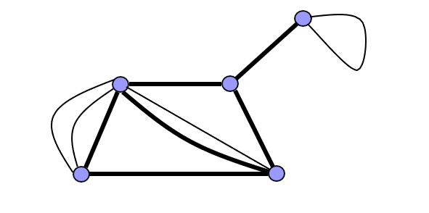
Subgraphs
Underlying simple graph is obtained by deleting all loops and all parallel edges between node pairs except one.

Slide 18
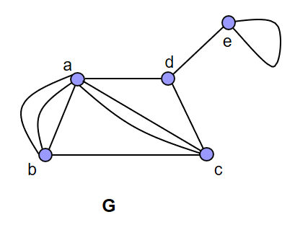
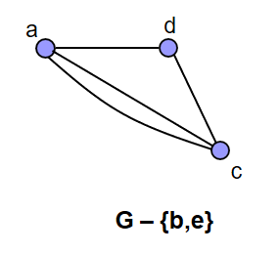
Induced Subgraph
The induced subgraph, denoted by G-V’, is obtained from G by deleting the vertices in V’ together with their incident edges.

Slide 19
Edge/Vertex Disjoint
Let G1 and G2 be subgraphs of G.
G1 and G2 are disjoint if they have no vertex in common.
They are edge-disjoint if they have no edge in common.

Slide 20
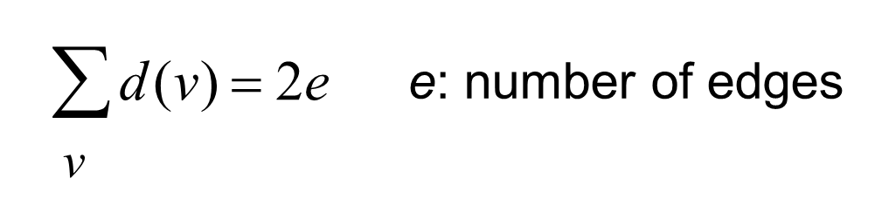
Vertex Degree
Degree: number of edges incident with a vertex
each loop counts as two.
Theorem:
Theorem: In any graph, the number of vertices of odd degree is even.
A graph is k-regular if d(v)=k for all vεV.
regular graphs, regular bipartite graphs Kn,n

Slide 21
Paths
Walk: A finite non-null sequence:
W = v0e1v1e2…ekvk
terms are alternately vertices and edges
for 1 ≤ i ≤ k the ends of ei are vi-1 and vi.
The vertices v0 and vk are called the origin and terminus of W.
A walk in a simple graph can be specified simply by its vertex sequence.

Slide 22
Paths
Trail: W is a trail, if the edges e1, e2, …, ek of the walk are distinct.
Path: If the vertices of a trail are distinct, it is called a path.
Two vertices u and v of a graph are connected if there is a path (u,v).
If all pairs are connected, then graph is also connected.

Slide 23
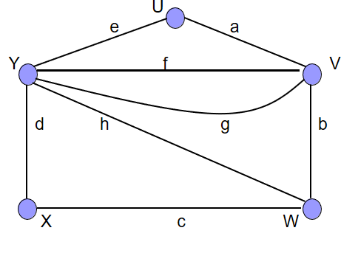
Example
walk: UaVfYfVgYhWbV
trail: WcXdYhWbVgY
path: XcWhYeUaV

Slide 24
Distance, Diameter, Cycle
The distance between u and v, dG(u,v) is the length of a shortest (u,v) path.
The diameter of G is the maximum distance between two vertices of G.
A walk is closed if its origin and terminus are the same.
A closed path is called a cycle.
k-cycle: A cycle of length k.
Theorem: A graph is bipartite if and only if it contains no odd cycle.

Slide 25
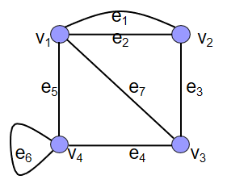
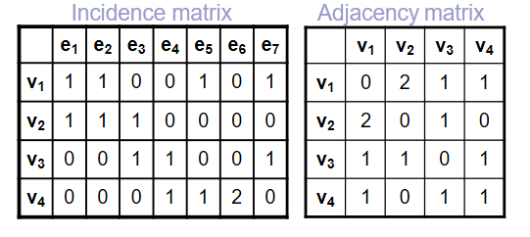
Incidence and Adjacency Matrices
Vertices: v1, v2, …, vv
Edges: e1, e2, …, eε
Incidence matrix: MG = [mij] where mij is the number of times that vi and ej are incident.
Adjacency matrix: AG = [aij] where aij is the number of edges joining vi and vj.

Slide 26
Directed graphs
If each edge has a direction, the graph is called a digraph.
The edge (u,v) is different from edge (v,u).
The degree of a vertex v:
in-degree d-(v): number of edges incident to v
out-degree d+(v): number of edges incident from v
The digraph is balanced if for every vertex v, d-(v) = d+(v)
Each digraph has an underlying undirected graph, obtained by deleting the direction of its edges.

Slide 27
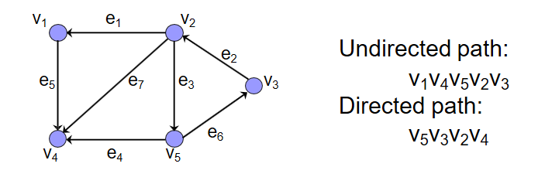
Directed Path
In a digraph, a directed path is an alternating sequence of vertices and edges:
^{S = v}1e1^{v}2e2^{…v}k-1ek-1^{v}k
where for all i, 1 ≤ i < k, ei is incident
from vi
to vi+1
Otherwise, S is an undirected path

Slide 28
Connectivity in Digraphs
Two types of connectivity:
Strongly connected
u and v are strongly connected if there is:
a directed (u,v) path, and
a directed (v,u) path
Weakly connected
u and v are weakly connected if there is:
an undirected (u,v) path

Slide 29
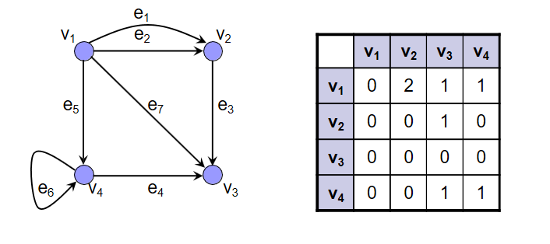
Adjacency Matrix of a Digraph
Vertices: v1, v2, …, vv
Edges: e1, e2, …, eε
Adjacency matrix: AG = [ajk] where ajk is the number of edges incident from vj to vk.

Slide 30
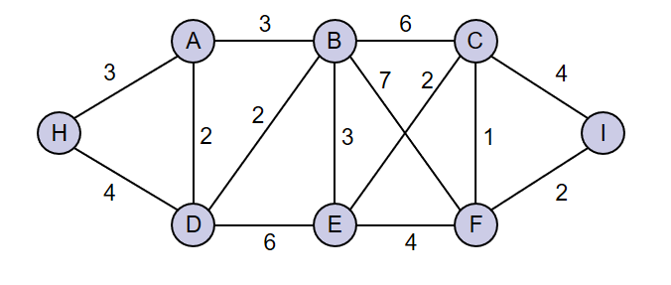
Weighted Graphs
Each edge is assigned a number.
cost, weight, length
Weight of a subgraph: Sum of all edges of the subgraph
Example: weight of a path

Slide 31
Asymptotic Growth
Complexity: Number of computational steps that it takes to transform the input data to the result of a computation.
This is a function of the problem size.
For graph algorithms, the problem size is determined by one or both
number of nodes
number of edges.

Slide 32
Algorithmic Complexity
For a problem size s, the complexity of an algorithm A is CA(s).
The complexity may vary significantly if A is applied to structurally different graphs of the same size.
We use worst-case complexity:
The maximum number of computational steps, over all inputs of size s.

Slide 33
Algorithmic Complexity
Let A1 and A2 be two algorithms for the same problem.
CA1(n) = n2/2
CA2(n) = 5n
A2 is faster than A1 for all n>10.
Asymptotic growth: As the problem size tends to infinity, growth of n2 is greater than n.
The complexity of A2 is of lower order than that of A1.

Slide 34
Order
Given two functions F and G whose domain is the natural numbers,
The order of F is lower than or equal to the order of G
if:
F(n) ≤ K . G(n)
K and n0 are positive constants.
We write: F = O(G)
Low order terms of a function can be ignored in determining the overall order.
Example: 3n3 + 6n2 + n + 6 is O(n3)

Slide 35
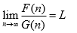
Comparing Two Functions
Let:
If L = a finite positive constant, then F = Θ(G)
If L = 0, then F is of lower order than G.
If L = ∞, then G is of lower order than F.

Slide 36
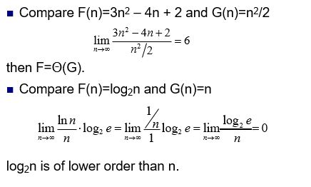
Examples

Slide 37
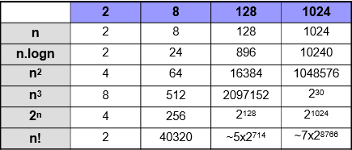
Comparison of Complexities
It can be shown that:
An exponential in n is of greater order than any polynomial in n.
Factorial n is of greater order than exponential in n.

Slide 38
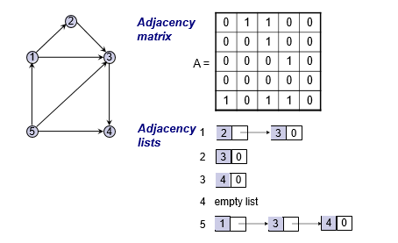
Example – Digraph representation

Slide 39
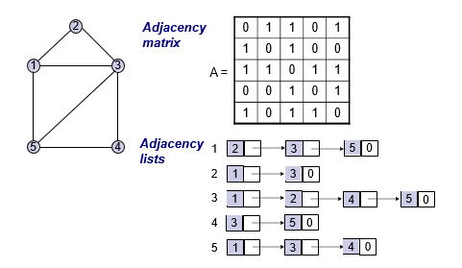
Example – Undigraph representation

Slide 40
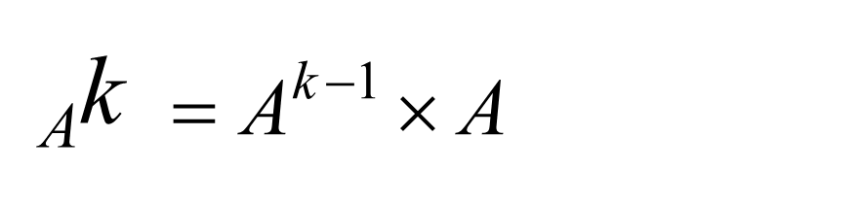
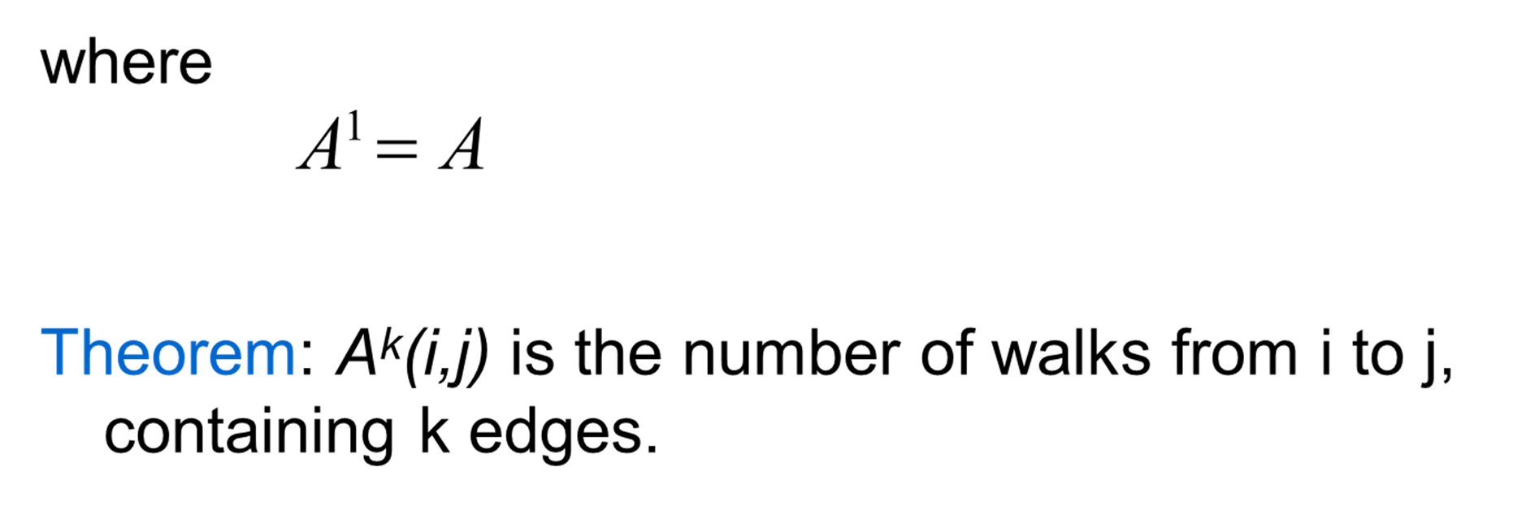
Products of Adjacency Matrix
A^{k}: k-th matrical product of the adjacency matrix

Slide 41
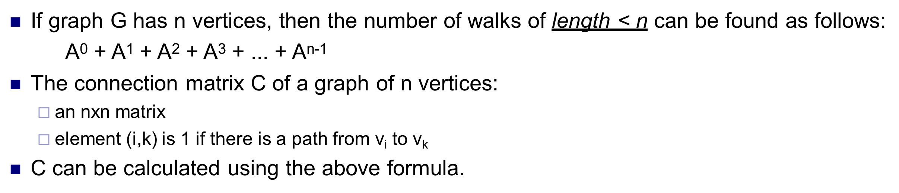
Connection Matrix

Slide 42
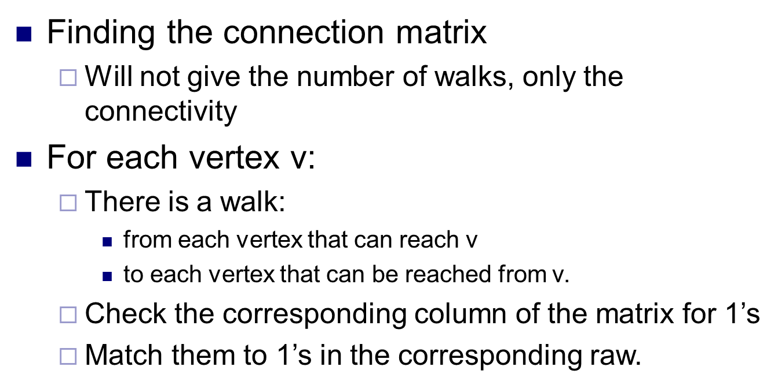
Warshall’s Algorithm

Slide 43
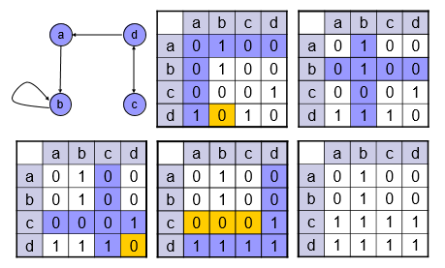
Example

Slide 44
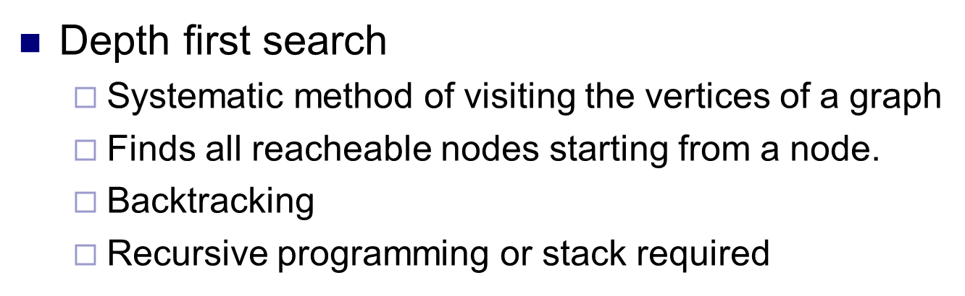
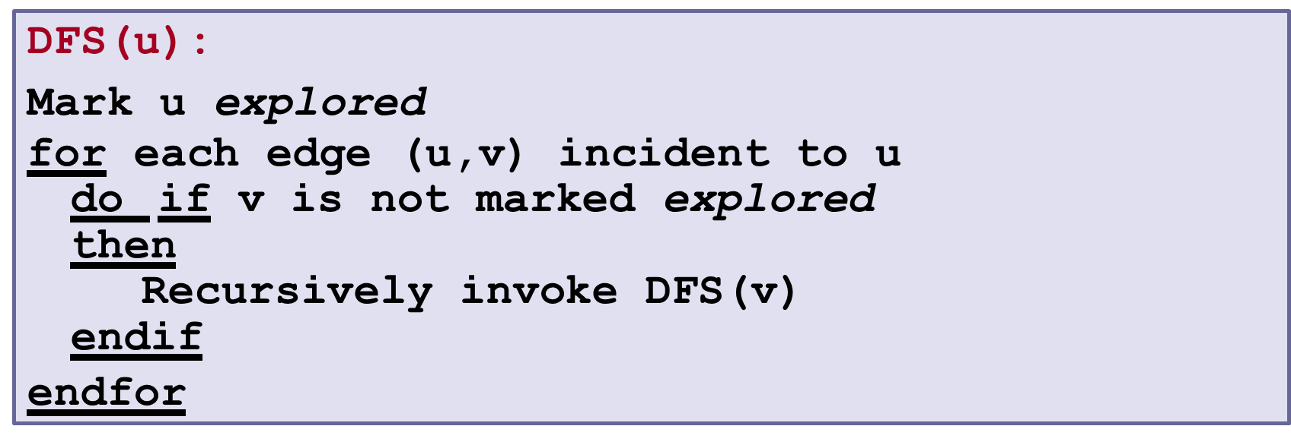
Graph Traversals

Slide 45
THANK YOU

